Slide 1

Ratings Prediction Project
Submitted By: Ajitesh Kumar

Slide 2
01
MORE THAN TEMPLATE
02
MORE THAN TEMPLATE
CONTENTS
03
MORE THAN TEMPLATE
04
MORE THAN TEMPLATE

Slide 3
BUSINESS PROBLEM FRAMING
Internet has revolutioning the way of shopping. Now we can do shopping seating in our homes by few clicks. The e-commerce industry is growing rapidly by extending it’s reach to almost every corner of the world. So, there are plenty of online marketing websites are avaiable and lot’s of product are available. This leads to confusion in our mind that from where we can get the best product.
Reviews & Ratings plays very significant role in deciding the corrrect product. Now a days, buyer can get the real idea about the product by reading the product reviews and ratings posted by the other buyers on the e-commerce website.
This problem is related to one such clients of FlipRobo Technologies who has a website where people write different reviews for technical products. Now they are adding a new feature to their website i.e. the reviewer will have to add stars(rating) as well with the review. The rating is out 5 stars and it only has 5 options available 1 star, 2 stars, 3 stars, 4 stars, 5 stars. Now they want to predict ratings for the reviews which were written in the past and they don’t have a rating. So, we have to build an application which can predict the rating by seeing the review.

Slide 4
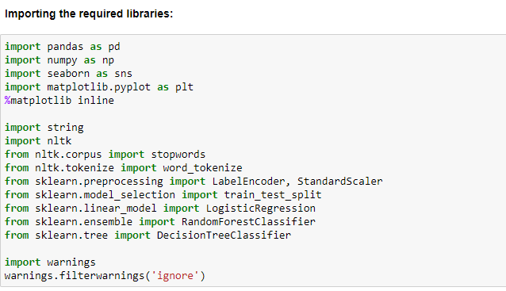
EXPLORATORY DATA ANALYSIS

Slide 5
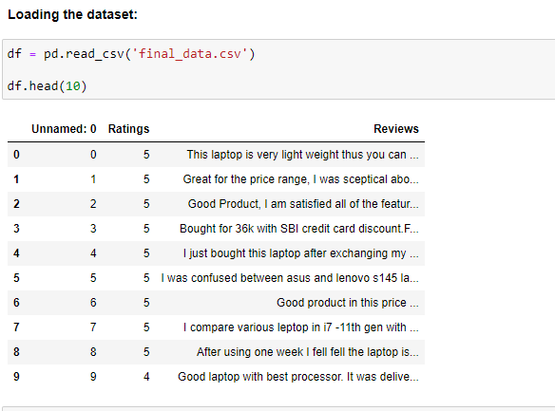

Slide 6
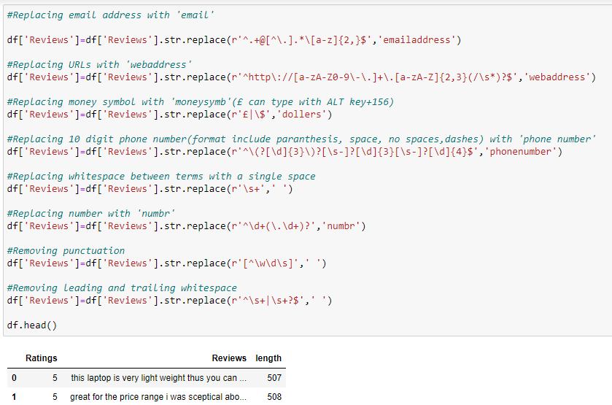
Data Preprocessing

Slide 7
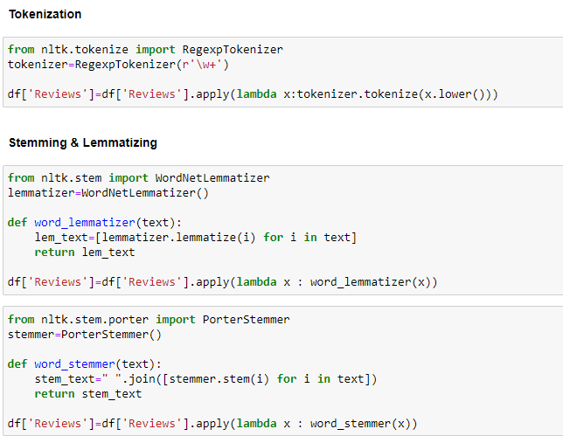

Slide 8
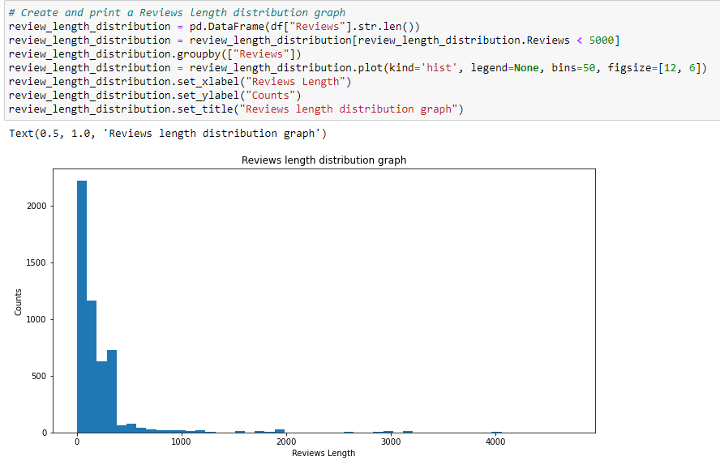
DATA VISUALIZATION

Slide 9
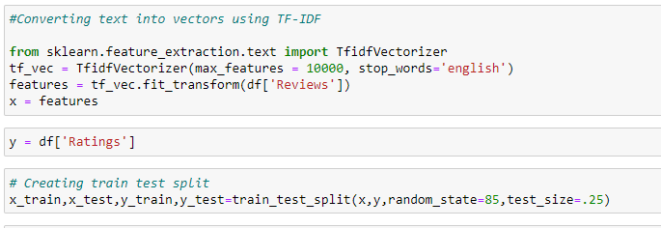
CONVERTING TEXT DATA TO VECTOR

Slide 10
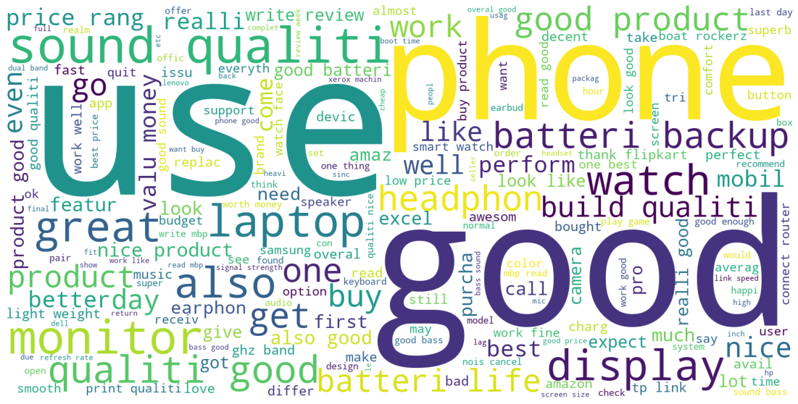
WORDCLOUD

Slide 11

MODEL BUILDING
lOGISTIC REGRESSION MODEL
DECISION TREE CLASSIFIER
K-NEIGHBOURS CLSSIFIER
RANDOM fOREST CLASSIFIER

Slide 12
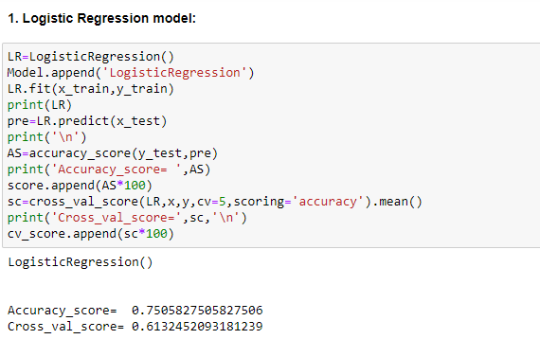
Logistic Regression

Slide 13
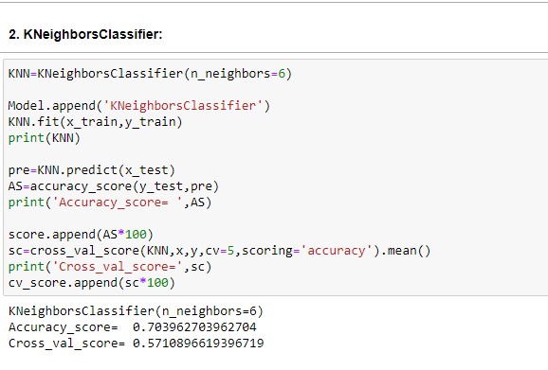
KNeighbors Classifier

Slide 14
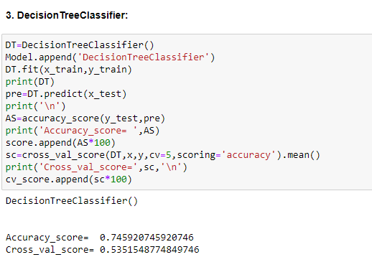
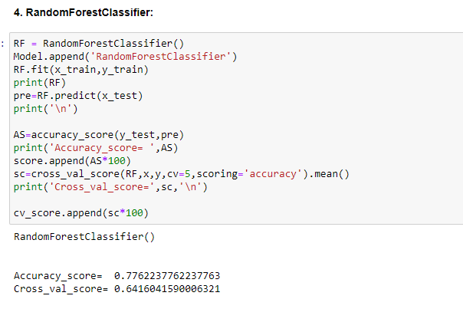
Decision Tree Classifier

Slide 15
Random Forest Classifier

Slide 16
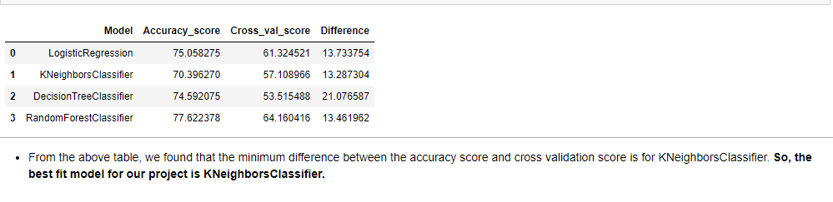
Conclusion

Slide 17
THANK YOU

